Slide 1
Remote Deposit Capture
The Advantage

Slide 2
At UniLink we recognize that Financial
Institutions are at different stages of adoption
or implementation of their Remote Deposit
Capture program…. with varying degrees of
results.
We would like to work with you to identify
ways to enhance your program.
We have crafted a modular Remote Deposit
Capture program that can be purchased
independently or customized to meet your
needs.
Remote Deposit Capture

Slide 3
Hardware –
With the growing number of companies, marketing
their scanners as the perfect choice, the decision to
pick the right scanner can be overwhelming.
At UniLink we take a truly Vendor Neutral approach
to your solution.
We stock a full complement of choices, all current brands and models to choose from.
We can ship the same day as ordered.
We can sell directly to you or your customers.
All at competitive pricing.
With over 200 years of cumulative experience in the Financial Industry we can provide you with a solution that best fits your needs.
Remote Deposit Capture

Slide 4
Customizable e-Commerce Platform -
Does the thought of becoming a warehouse with
inventory to manage seem unappealing?
We have developed a “brandable” e-commerce platform for
banks to:
complete product sales,
automatically fulfill orders,
track sales with our online reports.
Bank salespeople
can provide a link to this site directly to their merchant customers to order products,
and/or can use it themselves to order products.
Unilink will
process payment,
ship the product automatically,
bill the bank or the customer.
An online demo of this technology can be found at www.unilinkinc.com/bank
We eliminate the manual process of ordering and fulfillment!
Remote Deposit Capture

Slide 5
Customizable e-Commerce order site
Remote Deposit Capture

Slide 6
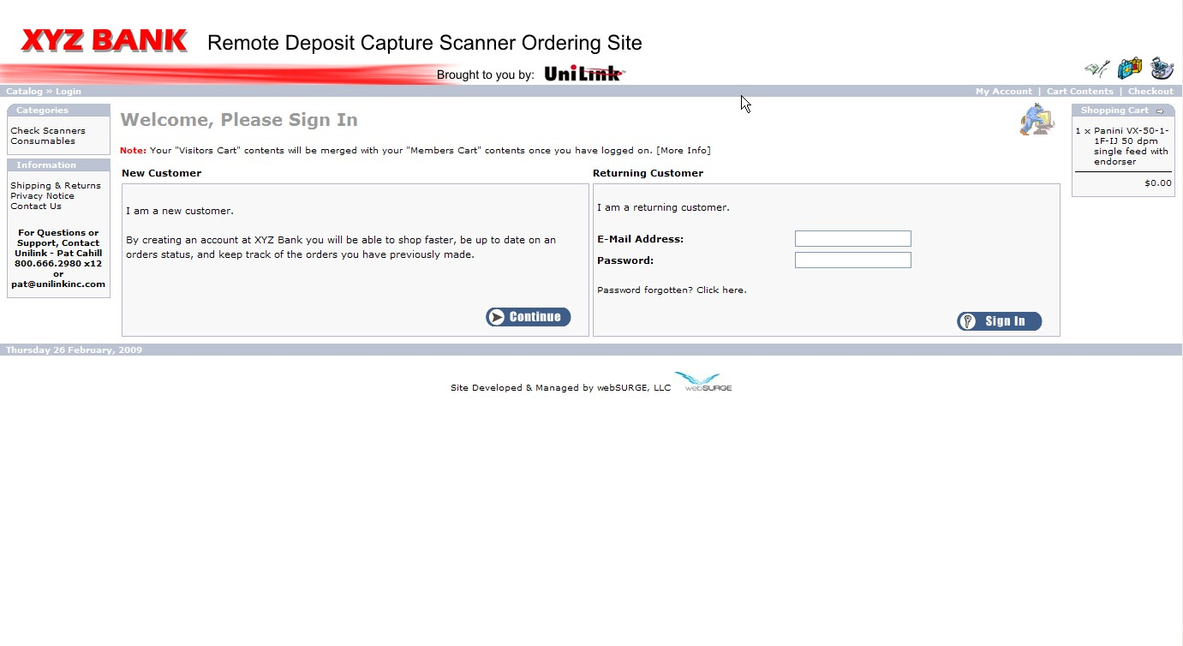
Account Creation/Login Page Example
Remote Deposit Capture

Slide 7
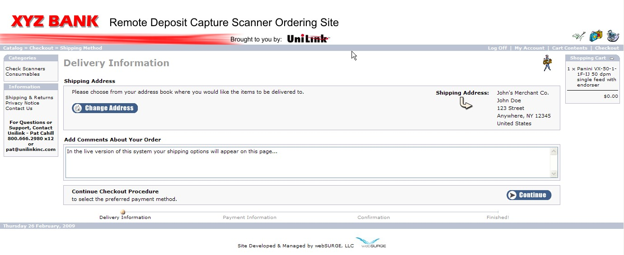
Shipping Page Example
Remote Deposit Capture

Slide 8
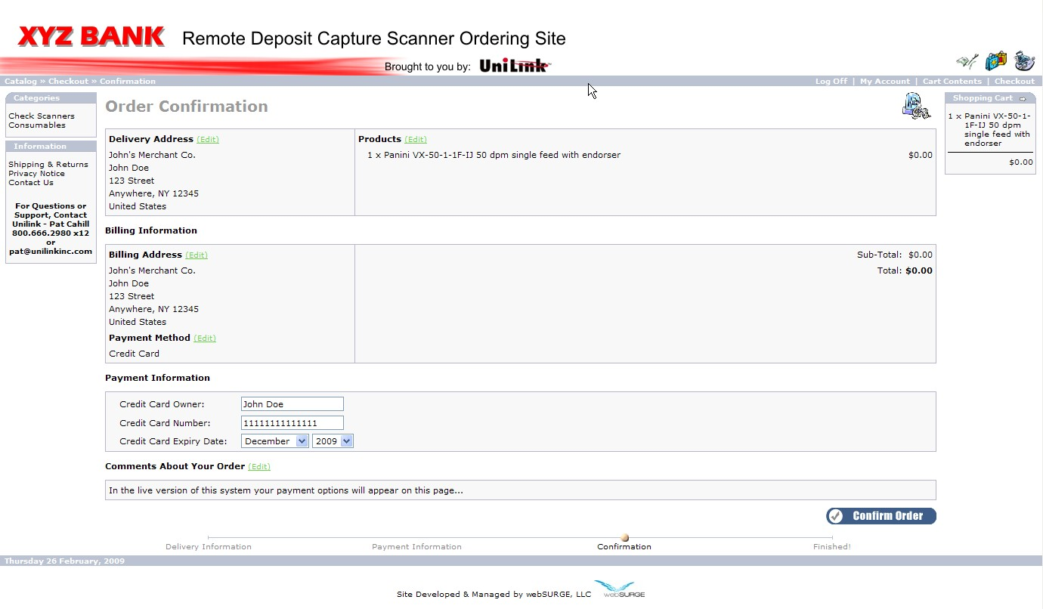
Confirmation/Payment Page Example
Remote Deposit Capture

Slide 9
Reporting Page Example
Bank officials can log in securely to view sales reports specific to their site to see when items are ordered, processed, shipped, and to obtain a tracking number. This allows for installation resources to be easily scheduled or to coordinate follow up discussions with your customers.
Remote Deposit Capture

Slide 10
Payment options –
At UniLink, we understand the complexities
of today’s financial environment.
That is why we offer a variety of payment methods including credit card, ACH, and direct invoicing.
We also added the ability to Lease equipment to your options. This offering extends to banks and consumers. This option allows banks to customize their programs for their customers.
Remote Deposit Capture

Slide 11
Service –
We have all the confidence in the durability of the
equipment we provide to you however certain
conditions can lead to equipment malfunction.
Have you prepared for this type of scenario?
UniLink is an Authorized National Service Depot for ALL scanners offered today.
With over 100 years of combined technical expertise we can customize a program that fits your requirements whether it is Next Day Advanced Exchange or Time and Materials basis.
We also team with all vendors regarding any maintenance offerings they provide.
You can count on UniLink to be there for your support!
Our staff is trained to triage your current situation and
determine if next level support is required.
Remote Deposit Capture

Slide 12
Marketing –
Are you uneasy about the ability to market and sell
Remote Deposit?
Does your Bank have limited resources?
We have developed a customizable video that demonstrates the advantages and benefits of Remote Deposit to consumers.
It can be branded to each specific bank that is selling scanners to their merchant customers.
The video also allows you to penetrate other markets within or outside your current geography, thus increasing your presence.
You can also target your approach by line of business such as Doctor, Lawyer or Insurance offices or by trade association through customization.
Available in CD, DVD or electronic format, the video can be provided directly to your customers, your sales staff, or played continuously in your Branch locations.
Our staff is comprised of individuals with over 200 years of cumulative experience, just a phone call away.
Custom Bank Sales Video (click here to register for viewing)
http://www.unilinkinc.com/bankvideo.html
Remote Deposit Capture

Slide 13
Consumable Supplies –
This is an area that most banks do not consider
when formulating their strategy for Remote
Deposit, but can be a critical element for your
customers.
At UniLink we provide:
A full array of consumable parts and supplies for all makes and models of scanners.
Through our website you or your customers can order supplies as needed and ship to various locations.
National Supplies Manager available to take your calls or provide triage support for you or your customers.
Remote Deposit Capture

Slide 14
We are your RDC partner!
Contact us for more information regarding our sales support programs!
(800) 666-2980
info@unilinkinc.com
www.unilinkinc.com
Remote Deposit Capture

